Slide 1
Homies City Collection Statistical Data on the Most Common Cities in the United States of America
Adil Ahmed, Colin Prince, Duong Nguyen, Karen Galindo Choudhary
Notes:
Karen

Slide 2
What Question Are We Answering?
Which U.S. City is the Best to Live In?
Notes:
Karen

Slide 3
Why Are We Looking At “Which U.S. City is the Best to Live in”?
People have different motivations for needing or wanting to move and they need an overall picture of the U.S.
To get all the information they need, they will have to look at many resources and documents. They need a one-stop tool and see all the information at a glance.
Notes:
Karen

Slide 4
Who Would Need This Information?
Married, No Kids
Recently graduated international students with multiple job offers
People with fixed incomes
A single person who is always on the move
Notes:
Karen

Slide 5
What is “Best”?
"Best" is a subjective term as well as a subjective measurement.
Each individual has a unique set of standards of what makes anything the best.
Searching for the "best city to live in" is no exception.
An individual's paradigm of what makes a city "the best to live in" can include everything from crime to pollution to cost-of-living.
Notes:
Karen

Slide 6
What Are the Characteristics Of The Cities?
Common Cities in U.S.
Across different states and regions
Represents varying qualities of life
Notes:
Karen

Slide 7
Which Metrics Did Homies Use?
Numbeo surveys the following list of parameters for the list of cities:
Crime: the concern of car theft or items from car stolen
Safety: the level of the feeling of safety when walking during the day and night
Quality of Life: a quantitative calculation of cost of living, purchasing power, pollution, crime rates, climate, health system quality and traffic commute times
Purchasing Power: a calculation of the various property values using aggregate data
Healthcare: the quality of the healthcare system
Cost of Living: an analysis of property values and property investment opportunities per city
Traffic Commute Time: the impact of time spent in traffic affects the quality of life in a city
Pollution: includes air, water, etc
Price to Income Ratio: the price of housing to household income ratio
Affordability: affordability of housing
Temperature: real-time temperature of the cities
Notes:
Adil

Slide 8
What Sources Did Homies Use?
Numbeo: the world’s largest database about worldwide housing (real estate) prices and its indicators based on surveys which determines the overall ratings per cities -FBI -U.S. Census Bureau
OpenWeatherAPI
Notes:
Adil

Slide 9
How Did We Work the Data?
Once we had the data from Numbeo we inserted it into an SQL Database
We removed the data that we did not need and merged it into one table
From there we transformed it into SQLite so that it could be more easily read by JavaScript
Notes:
Adil

Slide 10
What is in the HTML?
BootStrap: https://maxcdn.bootstrapcdn.com/bootstrap/3.3.7/css/bootstrap.min.css
D3: https://cdnjs.cloudflare.com/ajax/libs/d3/5.5.0/d3.js
CSS: static/css/style.css
Leaflet CSS: https://unpkg.com/leaflet@1.3.3/dist/leaflet.css
Leaflet Javascript: https://unpkg.com/leaflet@1.3.3/dist/leaflet.js
Placeholder for MapID
City Summary Statistics
Notes:
Adil

Slide 11
What is in the Web Design and UX?
Drop down menu showing all the U.S. Cities
Paragraph explaining the function of the tool
Map
City Summary Statistics: - City, affordability, cost of living, crime, health care, pollution, price to income ratio, purchasing power, quality of life, safety, traffic commute time, current temperature.
Notes:
Adil

Slide 12
Prepping the Data
From PostgreSQL to DB Browser for SQLite
Import and Export CSV
Updating the variables
Export Table to JSON as a back-up
Notes:
Duong

Slide 13
JSON, SQLite, Flask App, and Heroku
Using Pandas in Jupyter Notebook to prep the Flask App
Flask App allows a web app to be locally hosted in JSON format
JavaScript can now directly access the local host
Heroku allows the data to be hosted on the web
A proxy is used to overcome the CORS error
Alternatively, use a the JSON file
Notes:
Duong

Slide 14
Fun with JavaScript
Use D3 to pull up JSON data
Querying JSON data using mapping
Populate the drop down menu with the city names
Drop down menu select event on change
Summary statistics pop up when city selected
Weather API
Notes:
Duong

Slide 15
Leaflet Map Fun
Populating the map with city
Coordinates were pulled from Google API data
Adding markers
Bind pop-up to display data
Mouse over
Click on markers
Notes:
Duong

Slide 16
The Weather API via JavaScript
To gather the temperature information from the OpenWeatherAPI we used a library called Axios
Axios is a promise based HTTP client for the browser and node.js
The process is triggered by an individual changing what city they have selected
Notes:
Duong

Slide 17
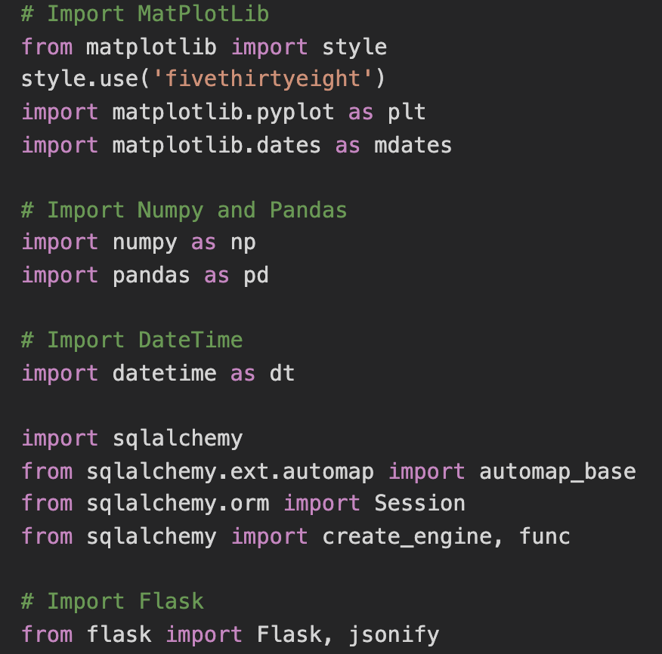
Libraries (Python)

Slide 18
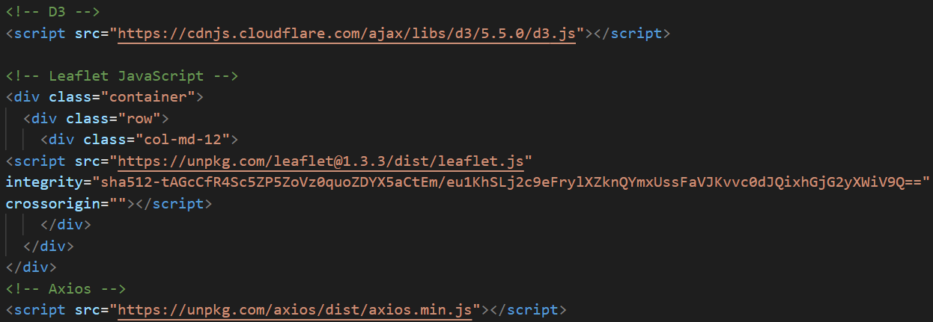
Libraries (JavaScript)
Notes:
Colin

Slide 19
Summary of Work
The creation of our webapp can be summarized into four parts:
We acquired the data and stored it in SQL.
We scripted functionality & design for the site in HTML and CSS.
We enabled the site to pull from the APIs and our database using JavaScript.
Finally, we mapped the locations & created the summary statistics in JavaScript.
Notes:
Colin

Slide 20
Post-Mortem
While we were successful in the JavaScript portion of the project, it took longer than anticipated.
We learned how to implement the library Axios, which is an incredibly powerful and useful asset to have when working with APIs.
There are additional things we would have included, such as more measurements for the cities, better map integration, and overall improved usability. Due to time constraints, we did what was most important.
Thank you!
Notes:
Colin

